Slide 1







Addressing Customer Churn at Power Co
Data-Driven Strategies for Retention
2024

Slide 2

1
Situation & Background
Situation: High customer churn rate at Power Co, impacting revenue and customer retention.
Background: Analyzing customer data to understand the reasons behind churn and developing strategies to mitigate it.

Slide 3


2
Identifying Challenges in Customer Churn at Power Co
High churn rate in specific customer segments.
Possible reasons include price sensitivity, service issues, and lack of engagement.

Slide 4
3
Questions & Hypothesis
Question:
What factors are leading to increased churn in the customer base of Power Co?
State Hypothesis:
We hypothesize that factors such as high prices and poor service quality are contributing to increased churn among Power Co's customers.
Objectives:
Identify the key factors driving churn.
Determine which customer segments are most at risk of churning.

Slide 5

4
Results & Recommandations

Slide 6
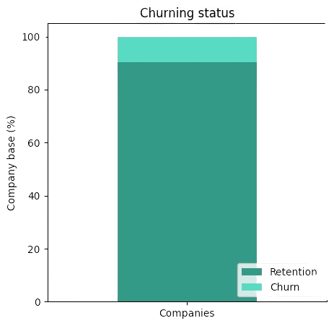
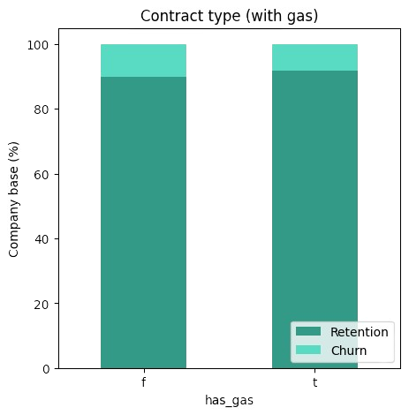
This visualization shows how many companies churned vs. how many companies did not churn. We can see from this that the churn rate is approximately 10%.
The fact that a client also has a gas contract does not significantly impact their churn.

Slide 7
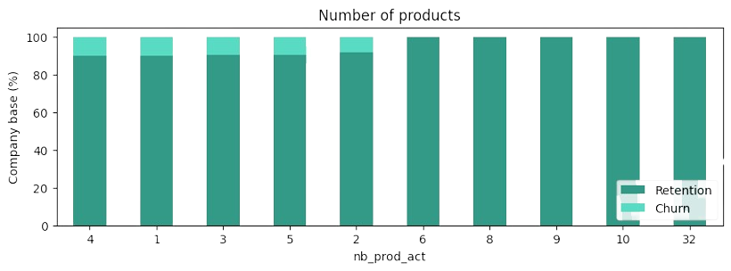
We can see that the higher the number of active products and services a company has, the lower its churn percentage. In fact, companies with more than 6 products or services have 0% churn.

Slide 8
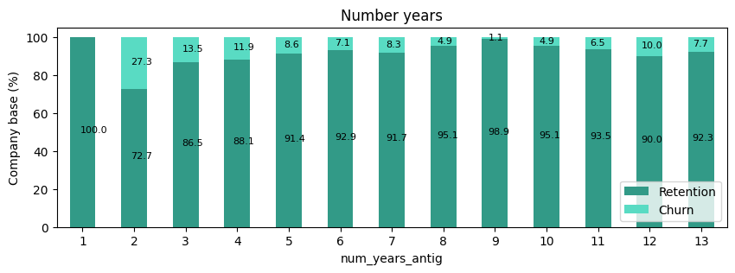
We can observe that the longer a company has been a client, the lower its churn rate. In the first year, the churn rate is 0%. However, 27% of companies churn after the second year, and 13% after the third year. Additionally, it is only after the fifth years that the churn rate drops below 10%.

Slide 9
Recommandations
Based on these findings, we recommend
Encourage clients to adopt a wider range of products and services. Implement cross-selling and upselling strategies to increase the number of active products and services for each client. This approach can help achieve higher customer retention and lower churn rates.
Implementing targeted retention strategies for clients in their second and third years, where churn rates are highest.
Developing loyalty programs or incentives for clients as they approach their fifth and eleventh years could help reduce churn rates and maintain customer loyalty.

